Slide 1
Testing types
Slack: Desktop Client for Communication tool
Olesia Ivanauskaite
01/20/2016

Slide 2

Agenda
Slack: Desktop Client for Communication tool
Positive Functional testing
Negative Functional testing
Functional testing: Smoke
Non-Functional testing: UI
Performance testing
Stress testing
Load testing
Localization testing

Slide 3

Slack: Desktop Client for Communication tool
Slack is an excellent online communication tool with a rich collection of settings and options. It works so well as a collaboration tool in business. Slack reduces the friction to working together as a team. It keeps everything in a central place and has a few nifty tricks to help to work a little smarter together.

Slide 4
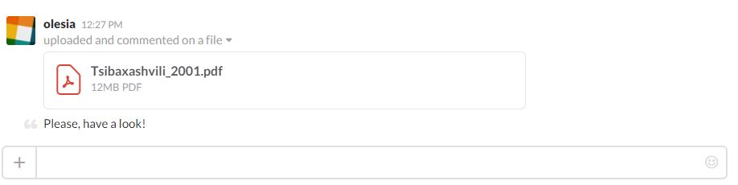
Positive Functional testing
Story: As a user I want to upload a file to the Slack window by dragging and dropping it from the computer.
Testing Procedure:
Open Slack: Desktop Client for Communication tool;
Sign in by entering a team’s Slack domain, personal email, and password;
Select a file<1GB to upload;
Drop and paste file to the Slack window;
Fill the Title, Share with and Add Comment fields (not required);
Click on Upload button.
Expected results:
File is successfully uploaded. You can click on it to open.

Slide 5
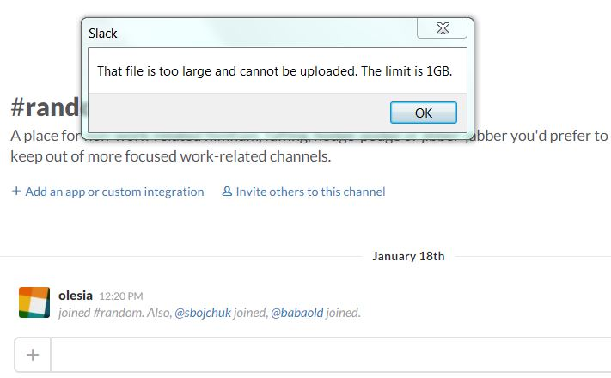
Negative Functional testing
Story: As a user I want to upload file that is >1GB to the Slack window.
Testing Procedure:
Open Slack: Desktop Client for Communication tool;
Sign in by entering a team’s Slack domain, personal email, and password;
Click the + next to the message box and select Upload a file;
Choose a file >1GB from the computer and press Open button.
Expected results:
File is not uploaded. A new window with a message ‘That file is too large and cannot be uploaded. The limit is 1GB’ appears on the screen.

Slide 6
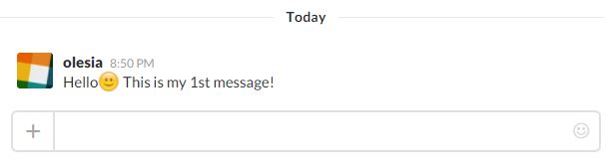
Smoke testing
Story: As a user I want to send a message by using Slack.
Functional Testing Procedure:
Open Slack: Desktop Client for Communication tool;
Sign in by entering a team’s Slack domain, personal email, and password;
Type a message in the form at the bottom of the screen;
Press Enter button.
Expected Results:
Full text message with all of the existing symbols is successfully sent.

Slide 7
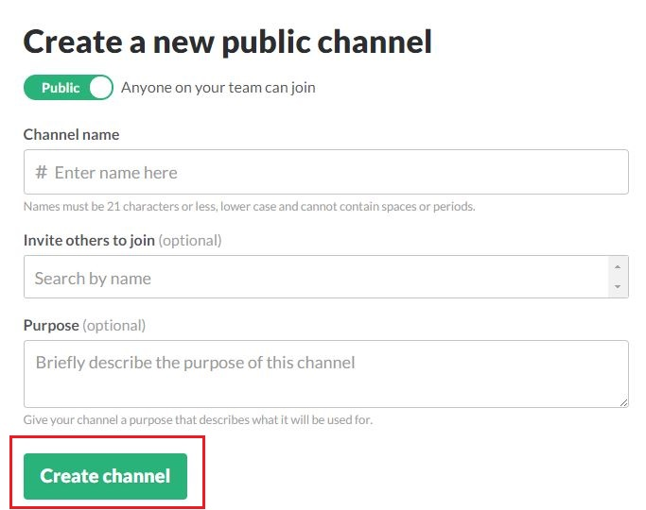
Non-functional testing: UI
Task: Verify the Create channel button UI
Preconditions:
Open Slack: Desktop Client for Communication tool;
Sign in by entering a team’s Slack domain, personal email, and password;
Click the + icon next to Channels in the sidebar to open the channel creation window.
UI testing procedure:
Verify that Create channel button is placed in the bottom left corner of the window;
Verify that Create channel is green coloured button;
Verify that a button text value is white coloured.

Slide 8



Performance testing
Task: Application should load in 10 sec when up to 2000 users access it concurrently. Application should load in 20 sec when up to 4000 users access it concurrently.
Performance Testing Procedure: emulate different amount of entrance in range (0; 4000), for instance, measure time for 100, 1000, 2000, 3000 and 3500, 4000 concurrent users.

Slide 9
Stress testing
Task: Test the stability of the product while 200 000 users are sending messages at one time.
Stress Testing Procedure:
Send 200 000 requests to send a message by using a special tool which can generate such amount of users and can provide results.
Expected results: The system can withstand a stress load.

Slide 10

Load testing
Task: Application should allow a user sent 60 messages per minute.
Load Testing Procedure: Test different amount of messages that can be send per minute (60, 65, 70);

Slide 11
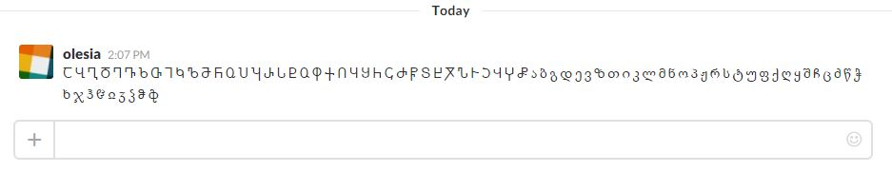
Localization testing
Story: As a user I would like to send a message in Georgian language.
Localization Testing Procedure:
Open Slack: Desktop Client for Communication tool;
Sign in by entering a team’s Slack domain, personal email, and password;
Type a message in Georgian language in the form at the bottom of the screen;
Press Enter button.
Expected results:
Message is successfully sent. All letters are displayed correctly.

Slide 12
Thank you
US OFFICES
Austin, TX
Fort Myers, FL
Boston, MA
Newport Beach, CA
Salt Lake City, UT
EUROPE OFFICES
United Kingdom
Germany
The Netherlands
Ukraine
Bulgaria
EMAIL
info@softserveinc.com
WEBSITE:
www.softserveinc.com
USA TELEPHONE
Toll-Free: 866.687.3588
Office: 239.690.3111
UK TELEPHONE
Tel: 0207.544.8414
GERMAN TELEPHONE
Tel: 0692.602.5857

